Slide 1
Module 04 – Exercise Class
ENSEMBLE LEARNING
(Random Forest – AdaBoost)
Nguyen Quoc Thai
MSc in Computer Science
Code-Data
Quiz&Feedback

Slide 2
Objectives
Ensemble Learning
Boosting
Introduction
Ensemble Methods
Learning Ensembles
Constructing Ensembles
Boosting Methods
AdaBoost
Calculate Weight
Sampling
Bagging
Implementation
Bootstrapping
Decision Tree
Random Forest
Extract Subset Training Data
Housing Dataset
Random Forest
AdaBoost
Sklearn

Slide 3

Outline
SECTION 1
Ensemble Learning
SECTION 2
Bagging Methods
SECTION 3
Boosting Methods
SECTION 4
Implementation
Notes:
Introduction: 45p
Application: 60p
MQA: 15p
Polars: 15p

Slide 4
Ensemble Learning
!
Decision Tree
Ensemble learning addresses the limitation of single decision trees by combining multiple trees to achieve better performance.
If the result from 1 tree is not good…
Why don’t we just use more trees?

Slide 5
Ensemble Learning
!
Example
Accuracy: 100%
Ground Truth | Predict 1 | Predict 2 | Predict 3 | Combine
0 | 0 | 0 | 0 | 0
0 | 0 | 1 | 0 | 0
0 | 0 | 0 | 1 | 0
0 | 1 | 0 | 0 | 0
1 | 1 | 0 | 1 | 1
1 | 1 | 1 | 1 | 1
1 | 1 | 1 | 1 | 1
1 | 0 | 1 | 1 | 1

Slide 6
Ensemble Learning
!
Learning Ensembles
Learn multiple alternative models using different training data or different learning algorithms
Training Data
Data 1
Data 2
Data 3
Model 1
Model 2
Model 3

Slide 7
Ensemble Learning
!
Learning Ensembles
Learn multiple alternative models using different training data or different learning algorithms
Training Data
Data 1
Data 2
Data 3
Model 1
Model 2
Model 3
Model Combiner
Combine decisions of multiple definitions,
e.g weighted voting
Final Result

Slide 8
Ensemble Learning
!
Methods for Constructing Ensembles
By manipulating the training set
By manipulating the input features
By manipulating the class labels
By manipulating the learning algorithm
KNN
Decision Tree
…
Original Data
Training Data
Model
Different hyperparameters
…

Slide 9
Ensemble Learning
!
Homogeneous Ensembles
Use a single, arbitrary learning algorithm but manipulate training data to make it learn multiple models
Ensemble Learning
Bagging
Boosting
Resample data
Useful to reduce the variance
Random Forest
Re-weight data
Useful to reduce the bias
AdaBoost
Gradient Boosting

Slide 10
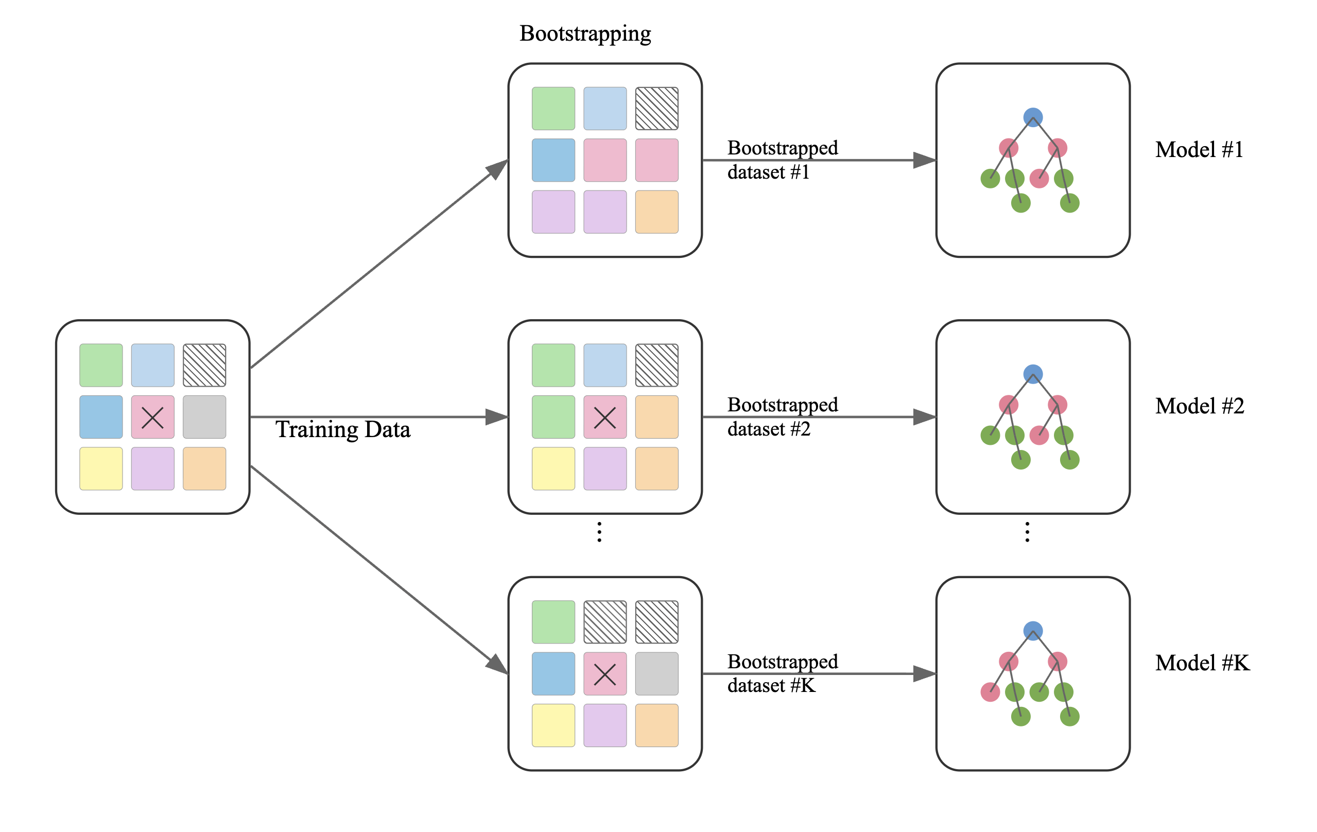
Outline
SECTION 1
Ensemble Learning
SECTION 2
Bagging Methods
SECTION 3
Boosting Methods
SECTION 4
Implementation
Notes:
Introduction: 45p
Application: 60p
MQA: 15p
Polars: 15p

Slide 11
Random Forest
!
Bagging (Bootstrapping Aggregating)
Dataset
Bootstrapping
Model 1
Model 2
Model 3
Aggregating

Slide 12
Random Forest
!
Bootstrapping
1
2
3
1
2
8
7
2
4
4
5
6
Sampling with replacement
4
3
9
2
5
6
7
8
9
1
2
9
7
3
8

Slide 13
Random Forest
!
Out-of-bag (OOB)
Unselected - OOB
1
2
3
1
2
8
7
2
4
3
5
6
9
4
5
6
Sampling with replacement
4
3
9
2
5
6
1
7
8
7
8
9
1
2
9
7
3
8
4
5
6
Original Dataset
Training Set
Test Set
Notes:
Trung bình, mỗi mẫu không xuất hiện trong ~36.8% số cây; dùng phần này để ước lượng OOB.

Slide 14
Random Forest
!
Aggregating
Dataset
Bootstrap Dataset
Evaluation: Test Set
Model 1
Model 2
Model 3
Voting
Averaging
0 | 1 | 1 | 1
0 | 0 | 1 | 0
1 | 1 | 1 | 1
1 | 2 | 3 | 2
1 | 3 | 2 | 2
1 | 1 | 1 | 1
Aggregating

Slide 15



Random Forest
!
Random Forest
Decision Tree
Random Forest
Dataset
Dataset

Slide 16
Random Forest
!
Decision Tree
Root Node: the top-level node
Node: internal node or decision node
Parent Node: a node that precedes a (child) node
Leaf: terminal node – a node at the end of a branch – represents outcome of the tree (label or numerical value)
Branches: a subset of a tree, starting at an (internal) node until the leaves
Root Node
Leaf
Node
Branch
Node
Leaf
Leaf
Leaf

Slide 17
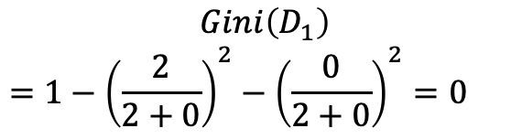
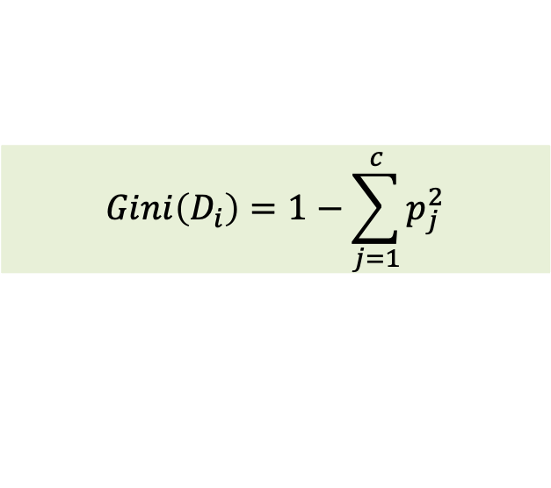
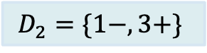
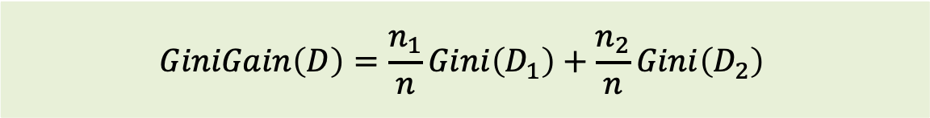
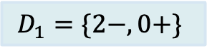
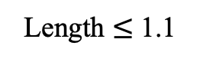
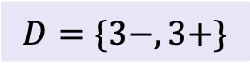
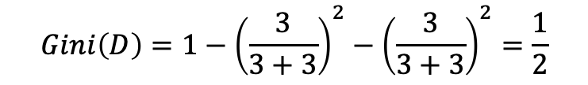
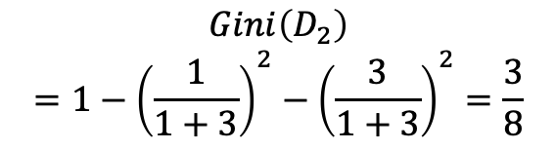
Random Forest
!
Decision Tree for Classification
$$GiniGain\left(D\right)=\frac{n_{1}}{n}Gini\left(D_{1}\right)+\frac{n_{2}}{n}Gini\left(D_{2}\right)$$
$$Gini\left(D_{i}\right)=1−\sum_{j=1}^{c}{p_{j}^{2}}$$
$$D=\{3−,3+\}$$
$$Gini\left(D\right)=1−{\left(\frac{3}{3+3}\right)}^{2}−{\left(\frac{3}{3+3}\right)}^{2}=\frac{1}{2}$$
True
False
Petal_Length | Petal_Width | Label
1 | 0.2 | 0
1.3 | 0.6 | 0
0.9 | 0.7 | 0
1.7 | 0.5 | 1
1.8 | 0.9 | 1
1.2 | 1.3 | 1
Length $≤$ 1.1
$$D_{1}=\{2−,0+\}$$
$$D_{2}=\{1−,3+\}$$
$$Gini\left(D_{1}\right)$$
$$=1−{\left(\frac{2}{2+0}\right)}^{2}−{\left(\frac{0}{2+0}\right)}^{2}=0$$
$$Gini\left(D_{2}\right)$$
$$=1−{\left(\frac{1}{1+3}\right)}^{2}−{\left(\frac{3}{1+3}\right)}^{2}=\frac{3}{8}$$
$$GiniGain\left(Length≤1.1\right)=\frac{2}{6}∗0+\frac{4}{6}∗\frac{3}{8}=\frac{1}{4}$$

Slide 18
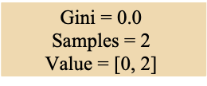
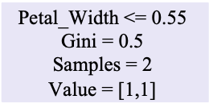
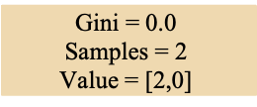
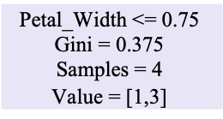
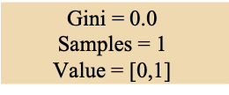
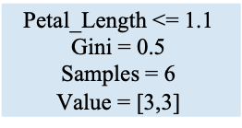
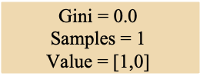
Random Forest
!
Decision Tree for Classification
$$GiniGain\left(D\right)=\frac{n_{1}}{n}Gini\left(D_{1}\right)+\frac{n_{2}}{n}Gini\left(D_{2}\right)$$
$$Gini\left(D_{i}\right)=1−\sum_{j=1}^{c}{p_{j}^{2}}$$
$$\text{Petal}\text{_}\text{Length}\text{ <= 1.1}$$
$$\text{G}\text{ini}\text{ = 0.5}$$
$$\text{S}\text{amples}\text{ = 6}$$
$$\text{V}\text{alue}\text{ = [3,3]}$$
Petal_Length | Petal_Width | Label
1 | 0.2 | 0
1.3 | 0.6 | 0
0.9 | 0.7 | 0
1.7 | 0.5 | 1
1.8 | 0.9 | 1
1.2 | 1.3 | 1
$$\text{G}\text{ini}\text{ = 0.}\text{0}$$
$$\text{S}\text{amples}\text{ = }\text{2}$$
$$\text{V}\text{alue}\text{ = [}\text{2}\text{,}\text{0}\text{]}$$
$$\text{Petal}\text{_}\text{Width}\text{ <= }\text{0.75}$$
$$\text{G}\text{ini}\text{ = 0.}\text{375}$$
$$\text{S}\text{amples}\text{ = }\text{4}$$
$$\text{V}\text{alue}\text{ = [}\text{1}\text{,3]}$$
$$\text{Petal}\text{_}\text{Width}\text{ <= }\text{0.55}$$
$$\text{G}\text{ini}\text{ = 0.5}$$
$$\text{S}\text{amples}\text{ = }\text{2}$$
$$\text{V}\text{alue}\text{ = [}\text{1}\text{,}\text{1}\text{]}$$
$$\text{G}\text{ini}\text{ = 0.}\text{0}$$
$$\text{S}\text{amples}\text{ = }\text{2}$$
$$\text{V}\text{alue}\text{ = [}\text{0, 2}\text{]}$$
$$\text{G}\text{ini}\text{ = 0.}\text{0}$$
$$\text{S}\text{amples}\text{ = }\text{1}$$
$$\text{V}\text{alue}\text{ = [}\text{0,1}\text{]}$$
$$\text{G}\text{ini}\text{ = 0.}\text{0}$$
$$\text{S}\text{amples}\text{ = }\text{1}$$
$$\text{V}\text{alue}\text{ = [}\text{1}\text{,}\text{0}\text{]}$$

Slide 19
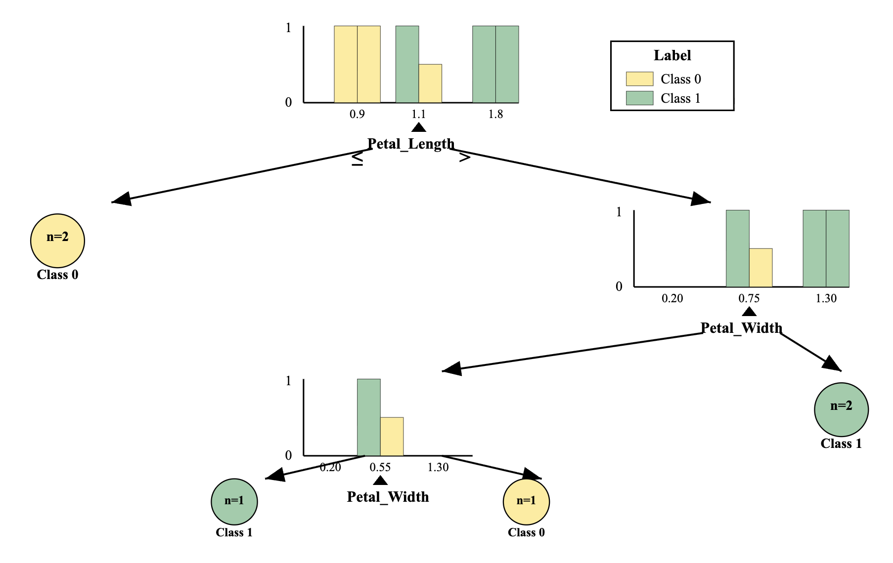
Random Forest
!
Decision Tree for Classification
$$GiniGain\left(D\right)=\frac{n_{1}}{n}Gini\left(D_{1}\right)+\frac{n_{2}}{n}Gini\left(D_{2}\right)$$
$$Gini\left(D_{i}\right)=1−\sum_{j=1}^{c}{p_{j}^{2}}$$
Petal_Length | Petal_Width | Label
1 | 0.2 | 0
1.3 | 0.6 | 0
0.9 | 0.7 | 0
1.7 | 0.5 | 1
1.8 | 0.9 | 1
1.2 | 1.3 | 1

Slide 20
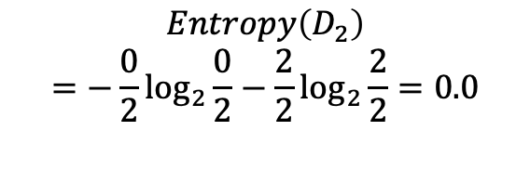
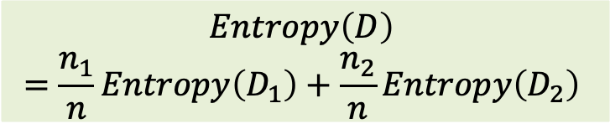
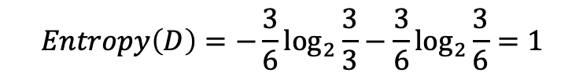
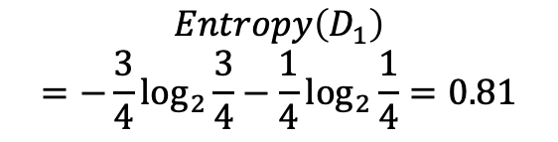
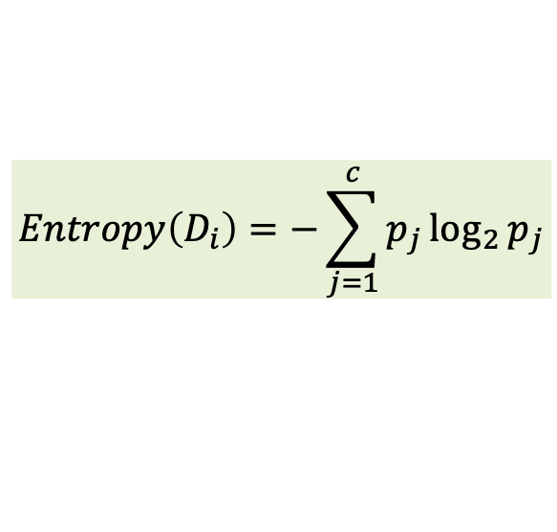
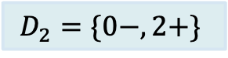
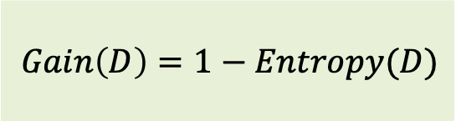
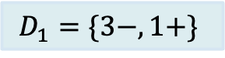
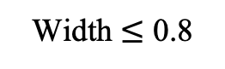
Random Forest
!
Decision Tree for Classification
$$Gain\left(D\right)=1−Entropy(D)$$
$$Entropy\left(D\right)$$
$$=\frac{n_{1}}{n}Entropy\left(D_{1}\right)+\frac{n_{2}}{n}Entropy\left(D_{2}\right)$$
$$Entropy\left(D_{i}\right)=−\sum_{j=1}^{c}{p_{j}\log_{2}{p_{j}}}$$
$$D=\{3−,3+\}$$
$$Entropy\left(D\right)=−\frac{3}{6}\log_{2}{\frac{3}{3}}−\frac{3}{6}\log_{2}{\frac{3}{6}}=1$$
True
False
Petal_Length | Petal_Width | Label
1 | 0.2 | 0
1.3 | 0.6 | 0
0.9 | 0.7 | 0
1.7 | 0.5 | 1
1.8 | 0.9 | 1
1.2 | 1.3 | 1
Width $≤$ 0.8
$$D_{1}=\{3−,1+\}$$
$$D_{2}=\{0−,2+\}$$
$$Entropy\left(D_{1}\right)$$
$$=−\frac{3}{4}\log_{2}{\frac{3}{4}}−\frac{1}{4}\log_{2}{\frac{1}{4}}=0.81$$
$$Entropy\left(D_{2}\right)$$
$$=−\frac{0}{2}\log_{2}{\frac{0}{2}}−\frac{2}{2}\log_{2}{\frac{2}{2}}=0.0$$
$$Entropy\left(Width≤0.8\right)=\frac{4}{6}∗0.81+\frac{2}{6}∗0.0=0.54$$
$$Gain\left(Width≤0.8\right)=1−0.54=0.46$$
Notes:
Introduction: 45p
Application: 60p
MQA: 15p
Polars: 15p

Slide 21
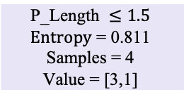
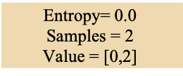
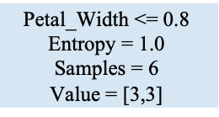
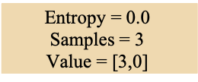
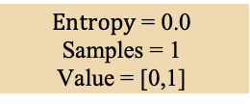
Random Forest
!
Decision Tree for Classification
$$Gain\left(D\right)=1−Entropy(D)$$
$$Entropy\left(D\right)$$
$$=\frac{n_{1}}{n}Entropy\left(D_{1}\right)+\frac{n_{2}}{n}Entropy\left(D_{2}\right)$$
$$Entropy\left(D_{i}\right)=−\sum_{j=1}^{c}{p_{j}\log_{2}{p_{j}}}$$
$$\text{Petal}\text{_}\text{Width}\text{ <= }\text{0}\text{.}\text{8}$$
$$\text{E}\text{ntropy}\text{ = }\text{1.0}$$
$$\text{S}\text{amples}\text{ = 6}$$
$$\text{V}\text{alue}\text{ = [3,3]}$$
Petal_Length | Petal_Width | Label
1 | 0.2 | 0
1.3 | 0.6 | 0
0.9 | 0.7 | 0
1.7 | 0.5 | 1
1.8 | 0.9 | 1
1.2 | 1.3 | 1
$$\text{P}\text{_}\text{Length} ≤1.5$$
$$\text{E}\text{ntropy}\text{ = 0.}\text{811}$$
$$\text{S}\text{amples}\text{ = }\text{4}$$
$$\text{V}\text{alue}\text{ = [}\text{3,1}\text{]}$$
$$\text{E}\text{ntropy}\text{= 0}\text{.0}$$
$$\text{S}\text{amples}\text{ = }\text{2}$$
$$\text{V}\text{alue}\text{ = [}\text{0}\text{,}\text{2}\text{]}$$
$$\text{E}\text{ntropy}\text{ = 0.}\text{0}$$
$$\text{S}\text{amples}\text{ = }\text{3}$$
$$\text{V}\text{alue}\text{ = [}\text{3,0}\text{]}$$
$$\text{E}\text{ntropy}\text{ = 0.}\text{0}$$
$$\text{S}\text{amples}\text{ = }\text{1}$$
$$\text{V}\text{alue}\text{ = [}\text{0}\text{,}\text{1}\text{]}$$
Notes:
Introduction: 45p
Application: 60p
MQA: 15p
Polars: 15p

Slide 22
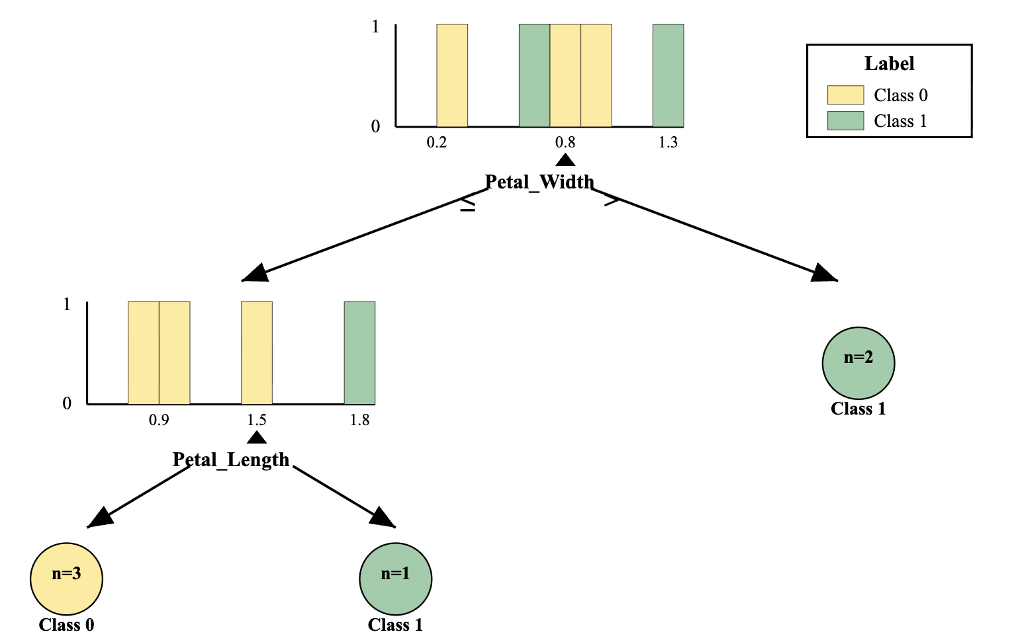
Random Forest
!
Decision Tree for Classification
$$Gain\left(D\right)=1−Entropy(D)$$
$$Entropy\left(D\right)$$
$$=\frac{n_{1}}{n}Entropy\left(D_{1}\right)+\frac{n_{2}}{n}Entropy\left(D_{2}\right)$$
$$Entropy\left(D_{i}\right)=−\sum_{j=1}^{c}{p_{j}\log_{2}{p_{j}}}$$
Petal_Length | Petal_Width | Label
1 | 0.2 | 0
1.3 | 0.6 | 0
0.9 | 0.7 | 0
1.7 | 0.5 | 1
1.8 | 0.9 | 1
1.2 | 1.3 | 1
Notes:
Introduction: 45p
Application: 60p
MQA: 15p
Polars: 15p

Slide 23

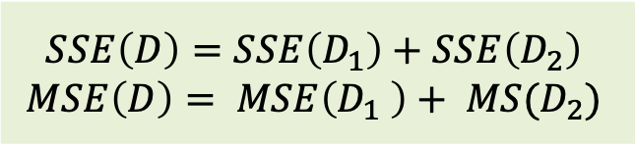
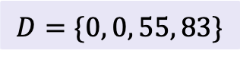
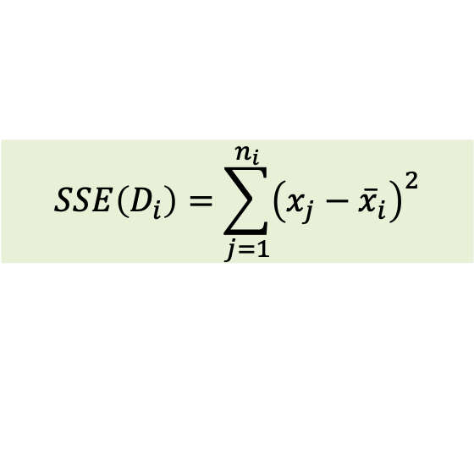
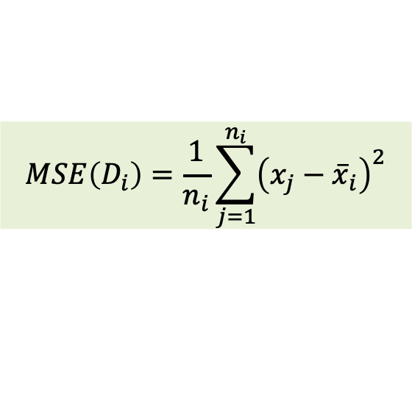
Random Forest
!
Decision Tree for Regression
$$SSE\left(D\right)=SSE\left(D_{1}\right)+SSE\left(D_{2}\right)$$
$$MSE\left(D\right)= MSE\left(D_{1} \right)+ MS(D_{2})$$
$$SSE\left(D_{i}\right)=\sum_{j=1}^{n_{i}}{{\left(x_{j}−{\overline{x}}_{i}\right)}^{2}}$$
$$MSE\left(D_{i}\right)=\frac{1}{n_{i}}\sum_{j=1}^{n_{i}}{{\left(x_{j}−{\overline{x}}_{i}\right)}^{2}}$$
$$D=\{0, 0, 55, 83\}$$
Experience | Salary
1.5 | 0
2.5 | 0
4.0 | 55
5.5 | 83
$$mean\left(D\right)=34.5$$
$$SSE\left(D_{1}\right)={\left(0−34.5\right)}^{2}+{\left(0−34.5\right)}^{2}+{\left(55−34.5\right)}^{2}+{\left(83−34.5\right)}^{2}=5153$$
$$MSE\left(D_{1}\right)=\frac{{\left(0−34.5\right)}^{2}+{\left(0−34.5\right)}^{2}+{\left(55−34.5\right)}^{2}+{\left(83−34.5\right)}^{2}}{4}=1288.25$$
Notes:
Introduction: 45p
Application: 60p
MQA: 15p
Polars: 15p

Slide 24
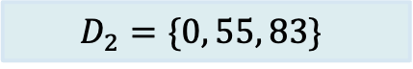
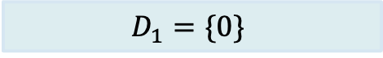



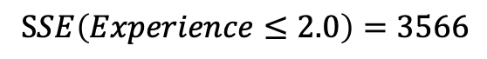
Random Forest
!
Decision Tree for Regression
$$SSE\left(D\right)=SSE\left(D_{1}\right)+SSE\left(D_{2}\right)$$
$$MSE\left(D\right)= MSE\left(D_{1} \right)+ MS(D_{2})$$
$$SSE\left(D_{i}\right)=\sum_{j=1}^{n_{i}}{{\left(x_{j}−{\overline{x}}_{i}\right)}^{2}}$$
$$MSE\left(D_{i}\right)=\frac{1}{n_{i}}\sum_{j=1}^{n_{i}}{{\left(x_{j}−{\overline{x}}_{i}\right)}^{2}}$$
$$D=\{0, 0, 55, 83\}$$
Experience | Salary
1.5 | 0
2.5 | 0
4.0 | 55
5.5 | 83
True
False
$$SSE(Experience≤2.0)$$
$$D_{1}=\{0\}$$
$$D_{2}=\{0, 55, 83\}$$
$$mean\left(D_{1}\right)=0$$
$$mean\left(D_{2}\right)=46$$
$$SSE\left(D_{1}\right)={\left(0−0\right)}^{2}=0$$
$$SSE\left(Experience≤2.0\right)=3566$$
$$SSE\left(D_{2}\right)={\left(0−46\right)}^{2}+{\left(55−46\right)}^{2}+{\left(83−46\right)}^{2}=3566$$
Notes:
Introduction: 45p
Application: 60p
MQA: 15p
Polars: 15p

Slide 25
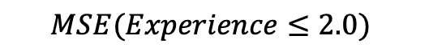
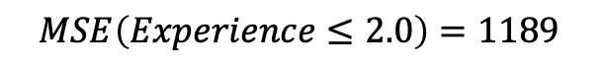
Random Forest
!
Decision Tree for Regression
$$SSE\left(D\right)=SSE\left(D_{1}\right)+SSE\left(D_{2}\right)$$
$$MSE\left(D\right)= MSE\left(D_{1} \right)+ MS(D_{2})$$
$$SSE\left(D_{i}\right)=\sum_{j=1}^{n_{i}}{{\left(x_{j}−{\overline{x}}_{i}\right)}^{2}}$$
$$MSE\left(D_{i}\right)=\frac{1}{n_{i}}\sum_{j=1}^{n_{i}}{{\left(x_{j}−{\overline{x}}_{i}\right)}^{2}}$$
$$D=\{0, 0, 55, 83\}$$
Experience | Salary
1.5 | 0
2.5 | 0
4.0 | 55
5.5 | 83
True
False
$$MSE(Experience≤2.0)$$
$$D_{1}=\{0\}$$
$$D_{2}=\{0, 55, 83\}$$
$$mean\left(D_{1}\right)=0$$
$$mean\left(D_{2}\right)=46$$
$$MSE\left(D_{1}\right)=\frac{{\left(0−0\right)}^{2}}{1}=0$$
$$MSE\left(Experience≤2.0\right)=1189$$
$$MSE\left(D_{2}\right)=\frac{{\left(0−46\right)}^{2}+{\left(55−46\right)}^{2}+{\left(83−46\right)}^{2}}{3}=1189$$
Notes:
Introduction: 45p
Application: 60p
MQA: 15p
Polars: 15p

Slide 26
Random Forest
!
Random Forest
A random forest
a supervised machine learning algorithm
the calculations of numerous decision trees are combined to produce one final result
Dataset
Data Sampling
Decision Tree Learners
Majority Voting / Averaging
Notes:
Ưu điểm
Khá mạnh & ổn định: giảm phương sai so với một cây đơn lẻ, ít overfit hơn DT.
Ít cần tiền xử lý: không bắt buộc scale/chuẩn hóa; xử lý feature hỗn hợp tốt.
Đánh giá nội bộ: có OOB error và permutation importance.
Song song hóa tốt: huấn luyện các cây độc lập → nhanh trên nhiều lõi.
Chống nhiễu nhãn tốt hơn boosting: không “ám ảnh” các điểm sai.
Nhược điểm
Kém diễn giải hơn một cây đơn; feature importance kiểu impurity thiên lệch với biến nhiều mức.
Tốc độ dự đoán & bộ nhớ có thể lớn nếu số cây nhiều.
Với mất cân bằng lớp, có thể thiên vị lớp đa số (cần class_weight/sampling).
Không giỏi ngoại suy ở bài toán hồi quy (giới hạn trong “bao” của dữ liệu huấn luyện).

Slide 27
Random Forest
!
Data Sampling
Length | Width | Label
1 | 0.2 | 0
1.3 | 0.6 | 0
0.9 | 0.7 | 0
1.7 | 0.5 | 1
1.8 | 0.9 | 1
1.2 | 1.3 | 1
Feature = 1
Dataset
Randomly sample with replacement
Length | Label
1 | 0
1.3 | 0
1 | 0
1.8 | 1
1.8 | 1
1.2 | 1
Width | Label
0.6 | 0
0.6 | 0
0.7 | 0
0.7 | 0
0.9 | 1
1.3 | 1
Length | Label
1 | 0
1.3 | 0
1.2 | 1
1.8 | 1
1.8 | 1
1.2 | 1

Slide 28

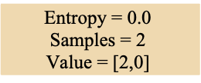
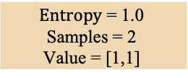
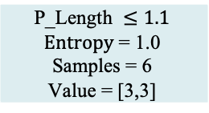
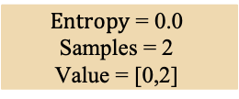
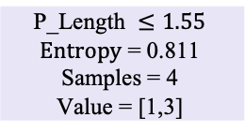
Random Forest
!
Decision Tree Learners
1
Length | Label
1 | 0
1.3 | 0
1 | 0
1.8 | 1
1.8 | 1
1.2 | 1
Dataset
$$\text{P}\text{_}\text{Length} ≤1.1$$
$$\text{E}\text{ntropy}\text{ = }\text{1.0}$$
$$\text{S}\text{amples}\text{ = }\text{6}$$
$$\text{V}\text{alue}\text{ = [}\text{3,3}\text{]}$$
$$\text{E}\text{ntropy}\text{ = 0.}\text{0}$$
$$\text{S}\text{amples}\text{ = }\text{2}$$
$$\text{V}\text{alue}\text{ = [}\text{2,0}\text{]}$$
$$\text{P}\text{_}\text{Length} ≤1.55$$
$$\text{E}\text{ntropy}\text{ = }\text{0.811}$$
$$\text{S}\text{amples}\text{ = }\text{4}$$
$$\text{V}\text{alue}\text{ = [}\text{1,3}\text{]}$$
$$\text{E}\text{ntropy}\text{ = }\text{1}\text{.}\text{0}$$
$$\text{S}\text{amples}\text{ = }\text{2}$$
$$\text{V}\text{alue}\text{ = [}\text{1}\text{,}\text{1}\text{]}$$
$$\text{E}\text{ntropy}\text{ = 0.}\text{0}$$
$$\text{S}\text{amples}\text{ = }\text{2}$$
$$\text{V}\text{alue}\text{ = [}\text{0}\text{,}\text{2}\text{]}$$

Slide 29
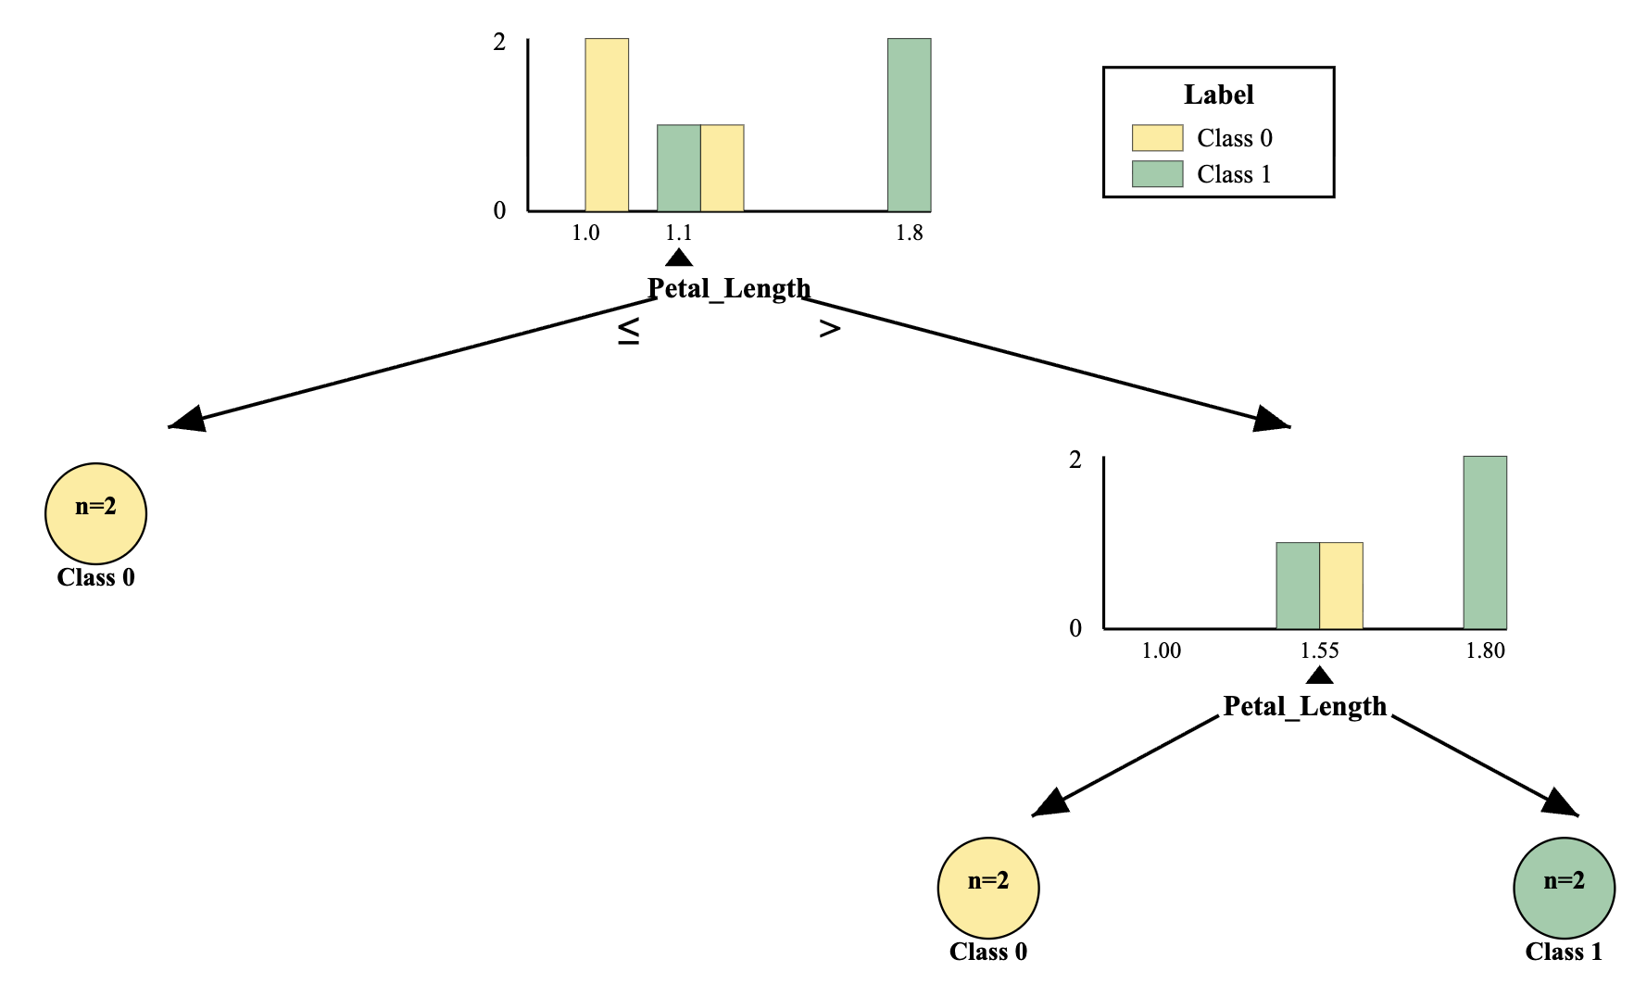
Random Forest
!
Decision Tree Learners
Length | Label
1 | 0
1.3 | 0
1 | 0
1.8 | 1
1.8 | 1
1.2 | 1
1
Dataset

Slide 30
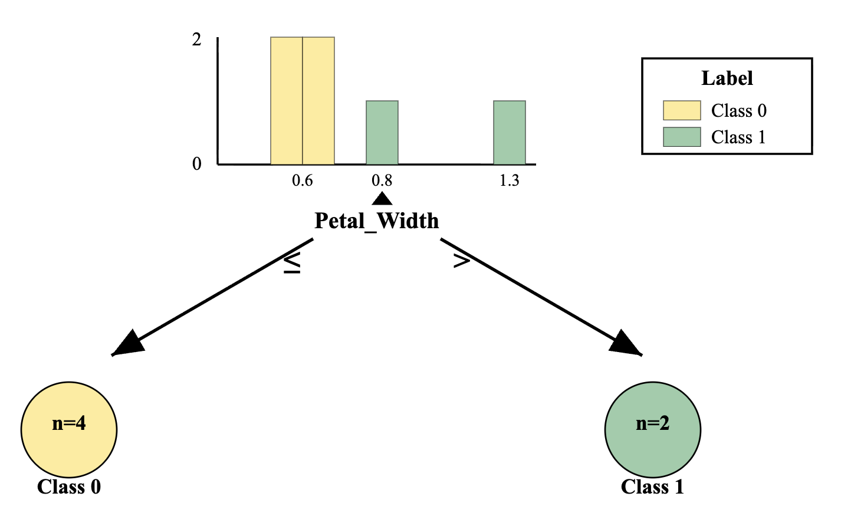
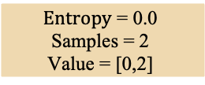


Random Forest
!
Decision Tree Learners
2
Width | Label
0.6 | 0
0.6 | 0
0.7 | 0
0.7 | 0
0.9 | 1
1.3 | 1
Dataset
$$\text{P}\text{_}\text{Width} ≤0.8$$
$$\text{E}\text{ntropy}\text{ = }\text{0.918}$$
$$\text{S}\text{amples}\text{ = }\text{6}$$
$$\text{V}\text{alue}\text{ = [}\text{4,2}\text{]}$$
$$\text{E}\text{ntropy}\text{ = 0.}\text{0}$$
$$\text{S}\text{amples}\text{ = }\text{4}$$
$$\text{V}\text{alue}\text{ = [}\text{4,0}\text{]}$$
$$\text{E}\text{ntropy}\text{ = 0.}\text{0}$$
$$\text{S}\text{amples}\text{ = }\text{2}$$
$$\text{V}\text{alue}\text{ = [}\text{0}\text{,}\text{2}\text{]}$$

Slide 31





Random Forest
!
Decision Tree Learners
3
Length | Label
1 | 0
1.3 | 0
1.2 | 1
1.8 | 1
1.8 | 1
1.2 | 1
Dataset
$$\text{P}\text{_}\text{Length} ≤1.1$$
$$\text{E}\text{ntropy}\text{ = }\text{0.918}$$
$$\text{S}\text{amples}\text{ = }\text{6}$$
$$\text{V}\text{alue}\text{ = [}\text{2,4}\text{]}$$
$$\text{E}\text{ntropy}\text{ = 0.}\text{0}$$
$$\text{S}\text{amples}\text{ = }\text{1}$$
$$\text{V}\text{alue}\text{ = [}\text{1,0}\text{]}$$
$$\text{P}\text{_}\text{Length} ≤1.25$$
$$\text{E}\text{ntropy}\text{ = }\text{0.722}$$
$$\text{S}\text{amples}\text{ = }\text{5}$$
$$\text{V}\text{alue}\text{ = [}\text{1,4}\text{]}$$
$$\text{E}\text{ntropy}\text{ = }\text{0}\text{.}\text{0}$$
$$\text{S}\text{amples}\text{ = }\text{2}$$
$$\text{V}\text{alue}\text{ = [}\text{0,2}\text{]}$$
$$\text{E}\text{ntropy}\text{ = 0.}\text{918}$$
$$\text{S}\text{amples}\text{ = }\text{3}$$
$$\text{V}\text{alue}\text{ = [}\text{1}\text{,}\text{2}\text{]}$$

Slide 32

Random Forest
!
Decision Tree Learners
3
Length | Label
1 | 0
1.3 | 0
1.2 | 1
1.8 | 1
1.8 | 1
1.2 | 1
Dataset

Slide 33
Random Forest
!
Majority Voting for Classification
Dataset
Test sample:
Petal_Length = 1.6
Petal_Width = 0.8
Class = 1
Class = 0
Class = 1
Majority Voting
Class = 1

Slide 34


Random Forest
!
Majority Averaging for Regression
Dataset
Salary = 0
Salary = 0
Test sample:
Experience = 3
Majority Averaging
Salary = (0+0)/2=0

Slide 35

Outline
SECTION 1
Ensemble Learning
SECTION 2
Bagging Methods
SECTION 3
Boosting Methods
SECTION 4
Implementation
Notes:
Introduction: 45p
Application: 60p
MQA: 15p
Polars: 15p

Slide 36
Boosting Methods
!
Boosting Methods
Updated (weight/value) Data
Updated (weight/value) Data
Original Data
…….
Model 1
Model 2
Model 3
…….

Slide 37




Boosting Methods
!
AdaBoost (Adaptive Boosting)
Original Data
Updated Data
Updated Data
weight
weight
…….
weight
Aggregating
Model 1
Model 2
Model 3
…….
$$α_{1},h_{1}(x)$$
$$α_{2},h_{2}(x)$$
$$α_{N},h_{N}(x)$$
Ensemble Model $f\left(x\right)=\sum{α_{t}h_{t}(x)}$

Slide 38

AdaBoost
!
Calculate weights of samples
Length | Width | Label
1 | 0.2 | 0
1.3 | 0.6 | 0
0.9 | 0.7 | 0
1.7 | 0.5 | 1
1.8 | 0.9 | 1
1.2 | 1.3 | 1
Length | Width | Label | Weight
1 | 0.2 | 0 | 1/6
1.3 | 0.6 | 0 | 1/6
0.9 | 0.7 | 0 | 1/6
1.7 | 0.5 | 1 | 1/6
1.8 | 0.9 | 1 | 1/6
1.2 | 1.3 | 1 | 1/6
Original Data
Initial sample weight = 1/N
Model 1
$$α_{1},h_{1}(x)$$

Slide 39



AdaBoost
!
Fitting model
Length | Width | Label | Weight
1 | 0.2 | 0 | 1/6
1.3 | 0.6 | 0 | 1/6
0.9 | 0.7 | 0 | 1/6
1.7 | 0.5 | 1 | 1/6
1.8 | 0.9 | 1 | 1/6
1.2 | 1.3 | 1 | 1/6
Length | Width | Label | Weight
1 | 0.2 | 0 | 1/6
1.3 | 0.6 | 0 | 1/6
0.9 | 0.7 | 0 | 1/6
1.7 | 0.5 | 1 | 1/6
1.8 | 0.9 | 1 | 1/6
1.2 | 1.3 | 1 | 1/6
Original Data
Initial sample weight = 1/N
Model 1
Fitting Model 1
$$\text{P}\text{_}\text{Width} ≤0.8$$
$$\text{E}\text{ntropy}\text{ = }\text{1.0}$$
$$\text{S}\text{amples}\text{ = }\text{6}$$
$$\text{V}\text{alue}\text{ = [}\text{3,3}\text{]}$$
$$\text{E}\text{ntropy}\text{ = 0.}\text{811}$$
$$\text{S}\text{amples}\text{ = }\text{4}$$
$$\text{V}\text{alue}\text{ = [}\text{3,1}\text{]}$$
$$\text{E}\text{ntropy}\text{ = 0.}\text{0}$$
$$\text{S}\text{amples}\text{ = }\text{2}$$
$$\text{V}\text{alue}\text{ = [}\text{0}\text{,}\text{2}\text{]}$$
$$α_{1},h_{1}(x)$$
Correct: 3
Incorrect: 1
Correct: 2
Incorrect: 0

Slide 40

AdaBoost
!
Calculate weights of weak learner
Length | Width | Label | Weight
1 | 0.2 | 0 | 1/6
1.3 | 0.6 | 0 | 1/6
0.9 | 0.7 | 0 | 1/6
1.7 | 0.5 | 1 | 1/6
1.8 | 0.9 | 1 | 1/6
1.2 | 1.3 | 1 | 1/6
Original Data
Initial sample weight = 1/N
Model 1
Fitting Model 1
$$\text{P}\text{_}\text{Width} ≤0.8$$
$$\text{E}\text{ntropy}\text{ = }\text{1.0}$$
$$\text{S}\text{amples}\text{ = }\text{6}$$
$$\text{V}\text{alue}\text{ = [}\text{3,3}\text{]}$$
Total error (Error rate)
$$ε_{1}=\sum_{incorrect}{w_{i}}=\frac{1}{6}$$
Weight of weak learner
$$α_{1}=\frac{1}{2}∗ln\frac{\left(1−ε_{1}\right)}{ε_{1}}=0.8$$
$$\text{E}\text{ntropy}\text{ = 0.}\text{811}$$
$$\text{S}\text{amples}\text{ = }\text{4}$$
$$\text{V}\text{alue}\text{ = [}\text{3,1}\text{]}$$
$$\text{E}\text{ntropy}\text{ = 0.}\text{0}$$
$$\text{S}\text{amples}\text{ = }\text{2}$$
$$\text{V}\text{alue}\text{ = [}\text{0}\text{,}\text{2}\text{]}$$
$$α_{1},h_{1}(x)$$
Correct: 3
Incorrect: 1
Correct: 2
Incorrect: 0

Slide 41



AdaBoost
!
Update weights of samples
For incorrect predictions
$$w_{new}=w∗e^{α}$$
$$=\frac{1}{6}∗e^{0.8}=0.37$$
Length | Width | Label | Weight
1 | 0.2 | 0 | 1/6
1.3 | 0.6 | 0 | 1/6
0.9 | 0.7 | 0 | 1/6
1.7 | 0.5 | 1 | 1/6
1.8 | 0.9 | 1 | 1/6
1.2 | 1.3 | 1 | 1/6
Original Data
Updated Data
weight
For correct predictions
$$w_{new}=w∗e^{−α}$$
$$=\frac{1}{6}∗e^{−0.8}=0.07$$
Model 1
Length | Width | Label | Weight
1 | 0.2 | 0 | 0.07
1.3 | 0.6 | 0 | 0.07
0.9 | 0.7 | 0 | 0.07
1.7 | 0.5 | 1 | 0.37
1.8 | 0.9 | 1 | 0.07
1.2 | 1.3 | 1 | 0.07
$$α_{1},h_{1}(x)$$
$$α_{1}=0.8$$

Slide 42
AdaBoost
!
Update weights of samples
For incorrect predictions
$$w_{new}=w∗e^{α}$$
$$=\frac{1}{6}∗e^{0.8}=0.37$$
Length | Width | Label | Weight
1 | 0.2 | 0 | 1/6
1.3 | 0.6 | 0 | 1/6
0.9 | 0.7 | 0 | 1/6
1.7 | 0.5 | 1 | 1/6
1.8 | 0.9 | 1 | 1/6
1.2 | 1.3 | 1 | 1/6
Original Data
Updated Data
weight
For correct predictions
$$w_{new}=w∗e^{−α}$$
$$=\frac{1}{6}∗e^{−0.8}=0.07$$
Model 1
Normalization
Length | Width | Label | Weight
1 | 0.2 | 0 | 0.1
1.3 | 0.6 | 0 | 0.1
0.9 | 0.7 | 0 | 0.1
1.7 | 0.5 | 1 | 0.5
1.8 | 0.9 | 1 | 0.1
1.2 | 1.3 | 1 | 0.1
Length | Width | Label | Weight
1 | 0.2 | 0 | 0.07
1.3 | 0.6 | 0 | 0.07
0.9 | 0.7 | 0 | 0.07
1.7 | 0.5 | 1 | 0.37
1.8 | 0.9 | 1 | 0.07
1.2 | 1.3 | 1 | 0.07
$$α_{1},h_{1}(x)$$
Total new weights = 0.72
$$α_{1}=0.8$$
0.07*1/0.72 = 0.1
0.37*1/0.72 = 0.5

Slide 43
AdaBoost
!
Create new data
Length | Width | Label | Weight
1 | 0.2 | 0 | 1/6
1.3 | 0.6 | 0 | 1/6
0.9 | 0.7 | 0 | 1/6
1.7 | 0.5 | 1 | 1/6
1.8 | 0.9 | 1 | 1/6
1.2 | 1.3 | 1 | 1/6
Original Data
Updated Data
weight
Model 1
Length | Width | Label | Weight | Random
1 | 0.2 | 0 | 0.1 | 0.0 => 0.1
1.3 | 0.6 | 0 | 0.1 | 0.1 => 0.2
0.9 | 0.7 | 0 | 0.1 | 0.2 => 0.3
1.7 | 0.5 | 1 | 0.5 | 0.3 => 0.8
1.8 | 0.9 | 1 | 0.1 | 0.8 => 0.9
1.2 | 1.3 | 1 | 0.1 | 0.9 => 1.0
Length | Width | Label | Weight
1 | 0.2 | 0 | 0.1
1.3 | 0.6 | 0 | 0.1
1.7 | 0.5 | 1 | 0.5
1.8 | 0.9 | 1 | 0.1
1.7 | 0.5 | 1 | 0.5
1.7 | 0.5 | 1 | 0.5
0.1
0.2
0.7
0.9
0.6
0.4
$$α_{1},h_{1}(x)$$
$$α_{1}=0.8$$

Slide 44
AdaBoost
!
Refresh new weights
Length | Width | Label | Weight
1 | 0.2 | 0 | 1/6
1.3 | 0.6 | 0 | 1/6
1.7 | 0.5 | 1 | 1/6
1.8 | 0.9 | 1 | 1/6
1.7 | 0.5 | 1 | 1/6
1.7 | 0.5 | 1 | 1/6
Original Data
Updated Data
weight
Model 1
$$α_{1},h_{1}(x)$$
$$α_{1}=0.8$$

Slide 45

AdaBoost
!
Fitting model 2 (Round 2)
Length | Width | Label | Weight
1 | 0.2 | 0 | 1/6
1.3 | 0.6 | 0 | 1/6
1.7 | 0.5 | 1 | 1/6
1.8 | 0.9 | 1 | 1/6
1.7 | 0.5 | 1 | 1/6
1.7 | 0.5 | 1 | 1/6
Original Data
Updated Data
weight
Model 1
Model 2
$$α_{1},h_{1}(x)$$
$$α_{2},h_{2}(x)$$
$$α_{1}=0.8$$

Slide 46





AdaBoost
!
Training Phase
Original Data
Updated Data
Updated Data
weight
weight
Model 1
Model 2
Model 3
$$α_{1}=0.8,h_{1}(x)$$
$$α_{2}=0.2,h_{2}(x)$$
$$α_{3}=0.6,h_{3}(x)$$

Slide 47




AdaBoost
!
Inference Phase
Test sample:
Petal_Length = 1.6
Petal_Width = 0.8
Model 1
Model 2
Model 3
1
0
1
$$α_{1}=0.8$$
$$α_{2}=0.2$$
$$α_{3}=0.6$$
$f\left(x\right)=\sum{α_{t}h_{t}\left(x\right)}=0.8∗1+0.2∗0+0.6∗1=1.4⇒1$

Slide 48




AdaBoost
!
Summary
Get subset training data
1
2
3
4
5
6
7
Sampling Probability
Initial sample weight = 1/N
Normalization
Fitting Model
For incorrect predictions
$$w_{new}=w∗e^{α}$$
Total error (Error rate)
$$ε_{1}=\sum_{incorrect}{w_{i}}$$
For correct predictions
$$w_{new}=w∗e^{−α}$$
Weight of weak learner
$$α_{1}=\frac{1}{2}∗ln\frac{\left(1−ε_{1}\right)}{ε_{1}}$$
Notes:
Ưu điểm
Hiệu quả cao với weak learners rất đơn giản (thường decision stump).
Giảm bias tốt; thường đạt độ chính xác cao trên dữ liệu sạch.
Ít siêu tham số: chủ yếu n_estimators, learning_rate (với đa lớp: SAMME/SAMME.R).
Mô hình cuối thường gọn (ít cây, cây nông) → dự đoán nhanh.
Nhược điểm
Nhạy với nhiễu nhãn & outliers: tăng trọng số cho điểm sai → dễ overfit nhiễu.
Huấn luyện tuần tự (ít song song hóa hơn RF).
Cần weak learner có lỗi < 0.5; nếu > 0.5 phải đảo nhãn/đảo dự đoán.
Với nhiều đặc trưng nhiễu, dễ tập trung nhầm vào “hard-but-noisy” samples.

Slide 49

Outline
SECTION 1
Ensemble Learning
SECTION 2
Bagging Methods
SECTION 3
Boosting Methods
SECTION 4
Implementation
Notes:
Introduction: 45p
Application: 60p
MQA: 15p
Polars: 15p

Slide 50







Implementation
!
Housing Dataset
Feature Normalization
Prediction
Evaluation
Random Forest Regressor
Boosting Regressor
Training Set
Test Set
Feature Normalization
Housing Dataset

Slide 51


Implementation
!
Housing Dataset

Slide 52


Implementation
!
Categorical Label Encoding

Slide 53


Implementation
!
Train Test Split

Slide 54



Implementation
!
Training & Evaluation

Slide 55


Slide 56
Summary
Ensemble Learning
Boosting
Introduction
Ensemble Methods
Learning Ensembles
Constructing Ensembles
Boosting Methods
AdaBoost
Calculate Weight
Sampling
Bagging
Implementation
Bootstrapping
Decision Tree
Random Forest
Extract Subset Training Data
Housing Dataset
Random Forest
AdaBoost
Sklearn
Notes:
Nên chọn gì khi nào?
Dữ liệu nhiễu, có outlier, ít tinh chỉnh → Random Forest (an toàn, ổn định).
Dữ liệu sạch, muốn model nhỏ gọn/nhanh dự đoán → AdaBoost (stumps + learning rate nhỏ).
Cần ước lượng lỗi nhanh không tách tập → RF (dùng OOB).
Cần hiệu năng tối đa trên bảng dữ liệu sạch → thử AdaBoost, rồi so với RF/Gradient Boosting/LightGBM.
Khắc. Phục nhược điểm
RF:
Dùng permutation importance thay cho impurity importance để giảm thiên lệch.
Giảm tương quan cây bằng max_features nhỏ hơn; xử lý imbalance với class_weight='balanced' hoặc resampling.
AdaBoost:
Giảm learning_rate, tăng n_estimators (shrinkage) để bền vững hơn.
Tiền xử lý lọc nhiễu/outlier, hoặc dùng robust weak learners.
Với đa lớp, ưu tiên SAMME.R nếu base learner có predict_proba.

